Slide 1
Using AI to Validate Carbon Containment in Illinois Basin Machine Learning Challenge
Kanna Swaminathan

Slide 2
Objectives
EXPLORATION
Time series injection information, well and storage reservoir monitoring data on carbon capture well
MODELLING
Understand and process injection and monitoring information for predicting injection rates deltas
INSIGHTS
Correlating the change in injection rate to the behaviour of other parameters can be used to provide a checkpoint against carbon migration from well or other losses during process – predicted information can be used to validate carbon containment

Slide 3
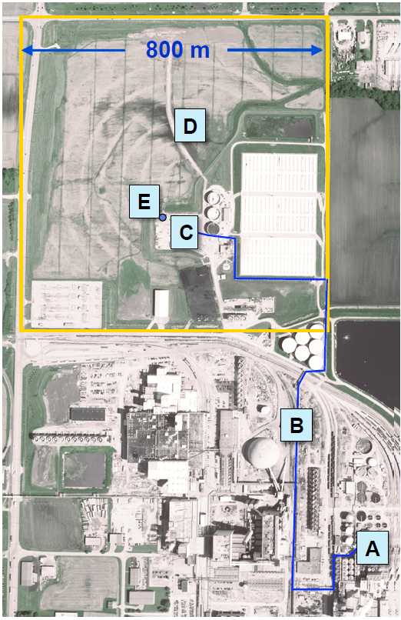
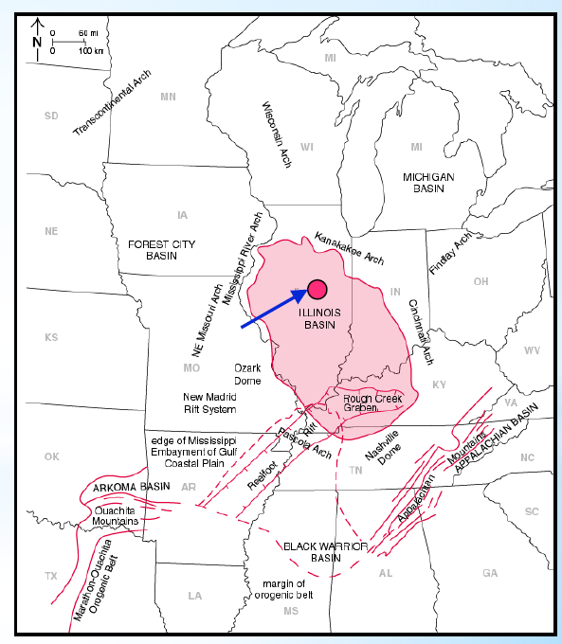
Background
Carbon Dioxide (CO₂) released from ethonal production at the ADM (Archer Daniels Midland) Company’s plant was compressed, dehydrated and injected into the Mt. Simom Sandstone
Mt Simon Sandstone is a saline aquifer located in the Illinois Basin and is approximately ~7,000 ft deep
Over three years (Nov-2011 to Nov-2014), ~1000 tonnes/d of CO₂ was injected into the reservoir
Cumulatively, 999,215 tonnes of supercritical CO₂ was injected and has been geologically stored in Mt Simon Sandstone
A: Facility
B: Pipeline
C: Injection Well
D: Observation Well
C: Geophones
Source: Bauer et al, 2019
Source: modified from Locke, 2012

Slide 4
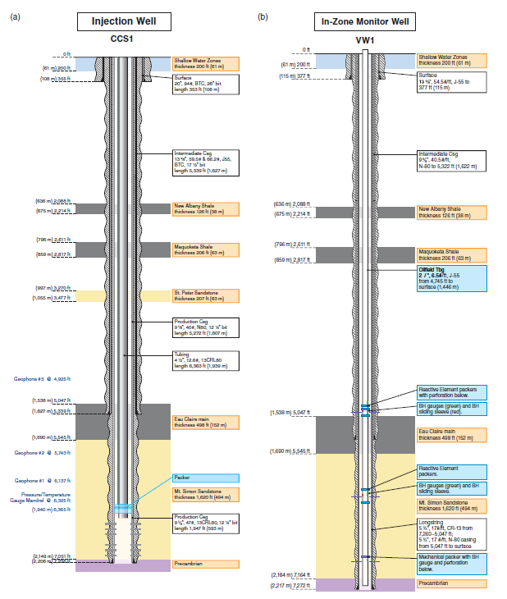
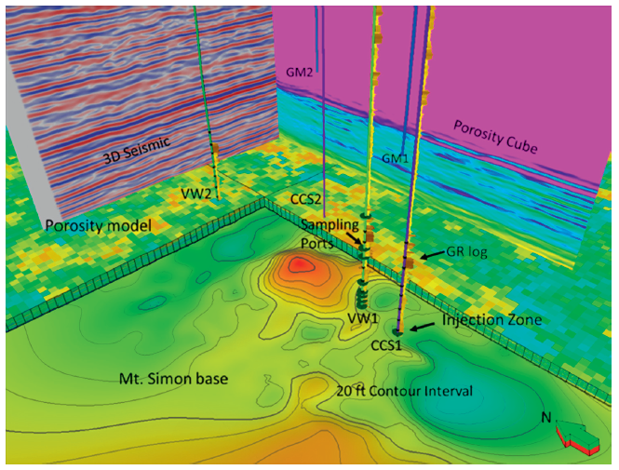
Data Collection
The injection and verification wells that are ~700ft apart are drilled downdip into the Mt Simon Sandstone
The wells were equipped with downhole sensors to monitor pressure and temperature at various depths of interest
Source: Bauer et al, 2019

Slide 5
Exploration
CO₂ Injection and Observation
Data and Sources

Slide 6



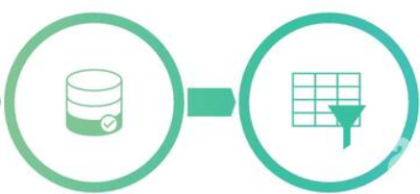








Methodology - Machine Learning
Data Collection
Data Preparation
Choose Learning Algorithm
Train the Model
Deployment/ Evaluation on a “Blind” Data Set
Test the Model

Slide 7
Dataset and Problem Framing
A total of 34 parameters measured in the injection and verification well
Parameters are comprised of both surface and downhole measurements
Target variable is the injection delta, defined as the difference in the injection rate at time t and time (t-1)
Dataset is available for full three years at hourly intervals (27,464 rows/hours)
27263 hours of data will be used to train a suitable model which will be use to predict 201 hours of injection delta in the future

Slide 8
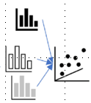
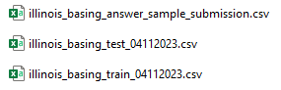
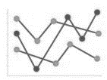
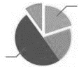

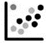
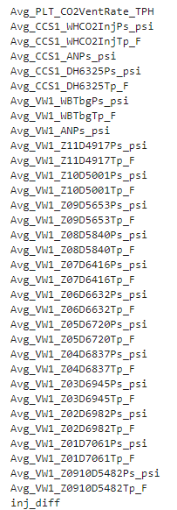
Exploratory Data Analysis
Exploratory Data Analysis
&
Statistics, grouping of variables, determining nature of variables
Load Data
Attributes?
Uni/ Bi/ Multivariant/ Statistics?
Missing Values, Aberrant, Outliers
Drop Data based on criteria
Relabel/Combine
Data Cleaning
X | Y
a | b |  | Z
a | b |  | c
a | b |  | NAN
a | b |  | NAN
a | b |  | NAN
 |  |  | NAN
Most time-consuming process; involved removing duplicates, fixing indexes, replacing incorrect characters, normalization of names etc
Notes:
Uni/ Bi/ Multivariant/ Statistics? Understanding unique values, duplicates

Slide 9
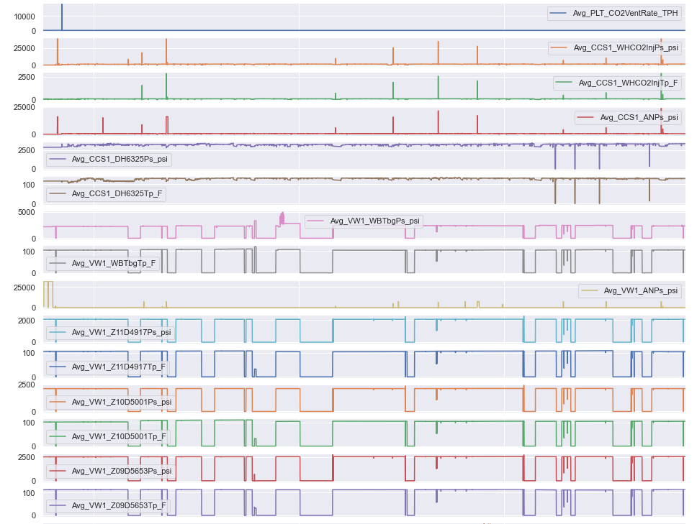
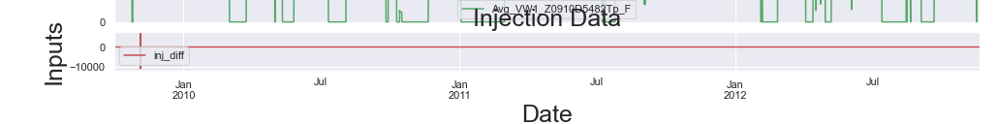
Data Orientation
Wealth of data available
Outlier presence
~25,000 psi WHP at injection well
0 psi downhole gauge pressure
Outliers likely caused by erroneous sensor readings/ reporting
Observation that there are variables with similar trends – correlatability check required
Target variable base is 0 psi. Deviation would result in –ve or +ve differences

Slide 10
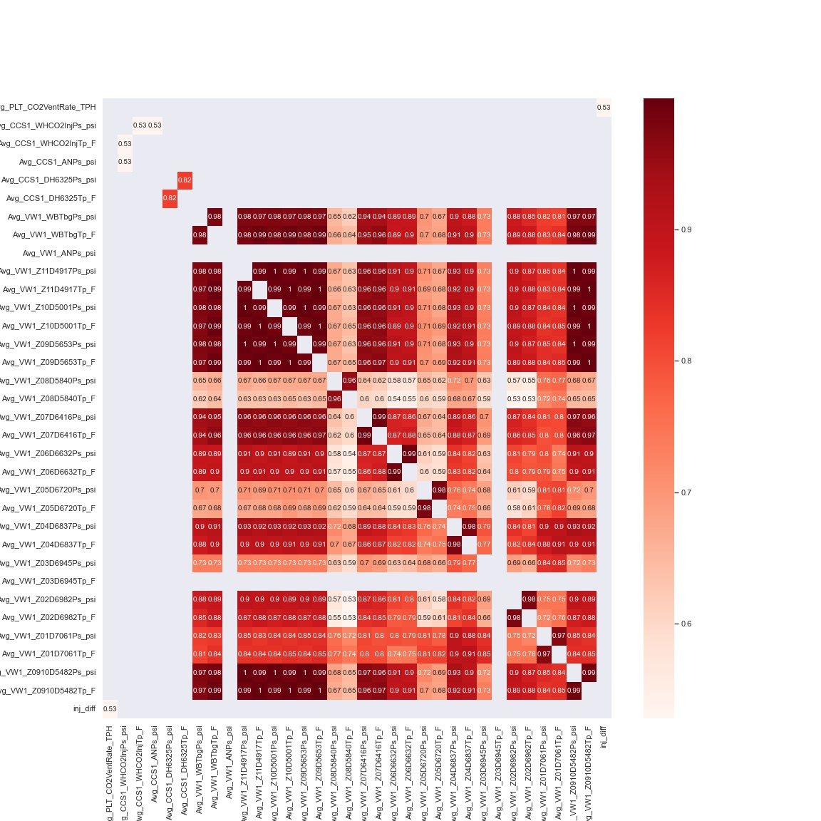
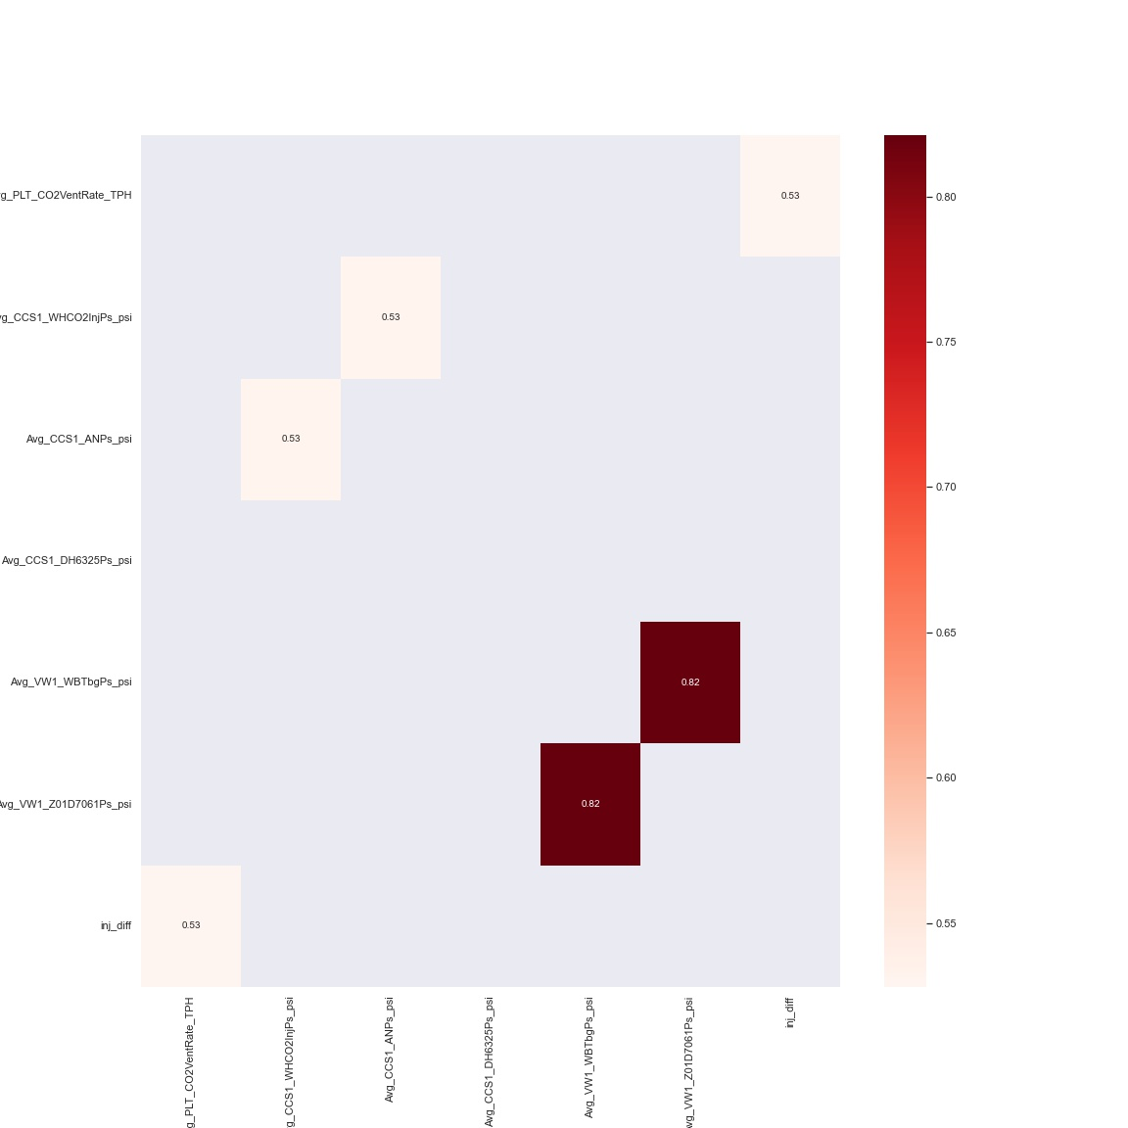
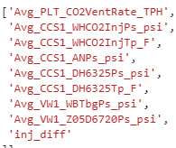
Data Selection
Most variables are highly correlatable, with values of > 0.5
Retained only one variable from groups of highly correleatable variables.
Exceptions are made if variables are found from different sources e.g. tubing and reservoir pressure at the observation well
Excluding the target injection delta variable, six variables retained for the machine learning application.
Notes:
Overall, it’s more impactful to focus on tackling the larger number of sources. Coal/Refinery still have actual rates that are higher

Slide 11
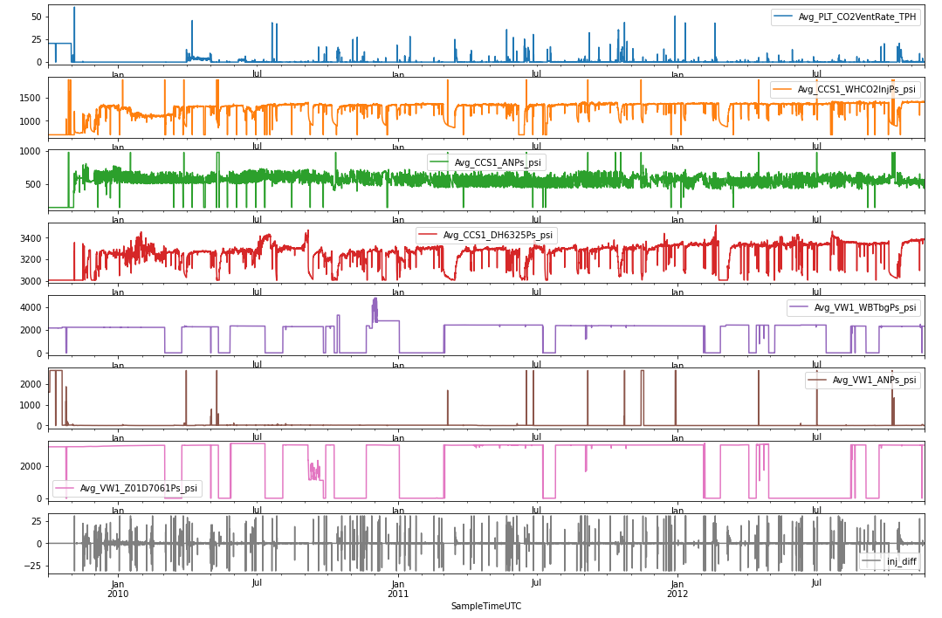
Outlier Removal
A modified Z-score is used to remove the outliers.
A more lenient score is used for injection delta and CO2 vent rate due to the difference in the magnitude’s range
The zero values at the observation well sensors have been kept – this will be tested for removal during the sensitization stage
Notes:
Overall, it’s more impactful to focus on tackling the larger number of sources. Coal/Refinery still have actual rates that are higher

Slide 12
Modelling
Selected Model and Injection Difference Prediction
LSTM

Slide 13
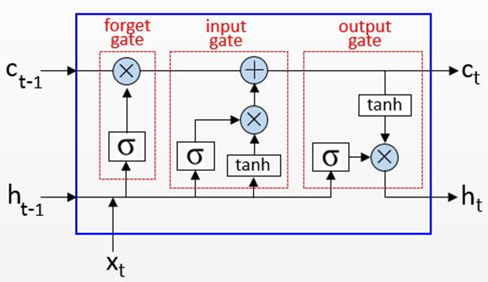
Selected Model – Long Short-Term Memory (LSTM)
LSTM is a type of recurrent neural network (RNN)
Learns from previous outputs to provide better results the following time
Typical LSTM has 3 layers
Input gate which assigns weights based on the significance of different variables,
Forget gate to retain only useful information, and
Output gate which manages the information flow
LSTM holds a memory cell which retains captured information over longer time periods and preserves useful constituents using its input and forget gates, hence avoiding the vanishing gradient issue associated with traditional RNNs
Before building the LSTM model, the time series sequence must be split into samples.
The reason is due to LSTM’s nature of being a memory-based model, which retrieves information from sequences to create forecasts.
Note. By Rainardi, V., 2021, RNN and LSTM. Accessed at https://dwbi1.wordpress.com/2021/08/07/recurrent-neural-network-rnn-and-lstm/

Slide 14
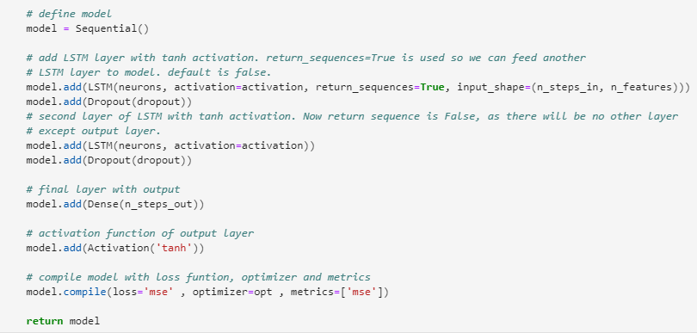
Employed Architecture
Employed architecture of the LSTM consist of two LSTM layers
The first LSTM layer has activated the return sequences to be true so that it can use the output of each timestep as an input for the next LSTM layer
The second LSTM does not have this activated as it is the last layer in the output sequence
Tanh activation function
A dropout layer is added after each LTSM layer to prevent overfitting
Finally, there is a Dense layer which predicts a single timestep at a time
Model is compiled using MSE (Mean Squared Error) as the loss function and the evaluation metric

Slide 15
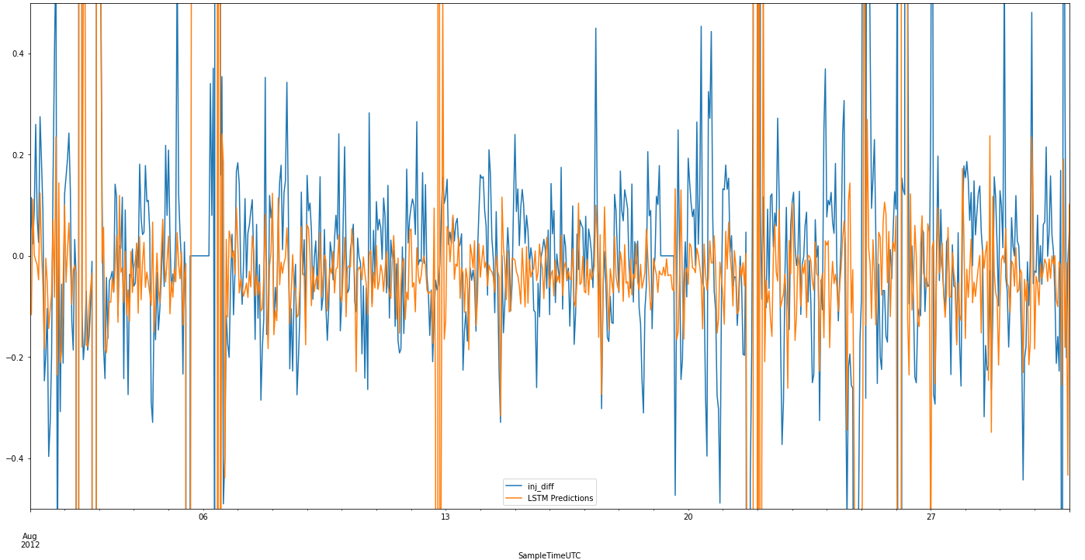
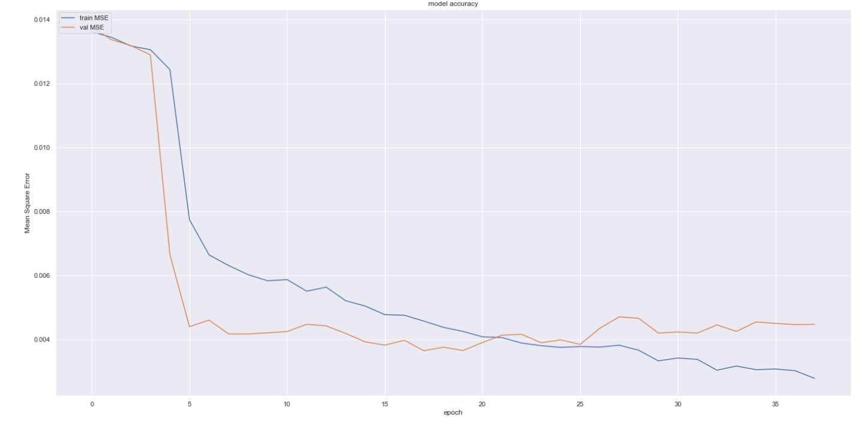
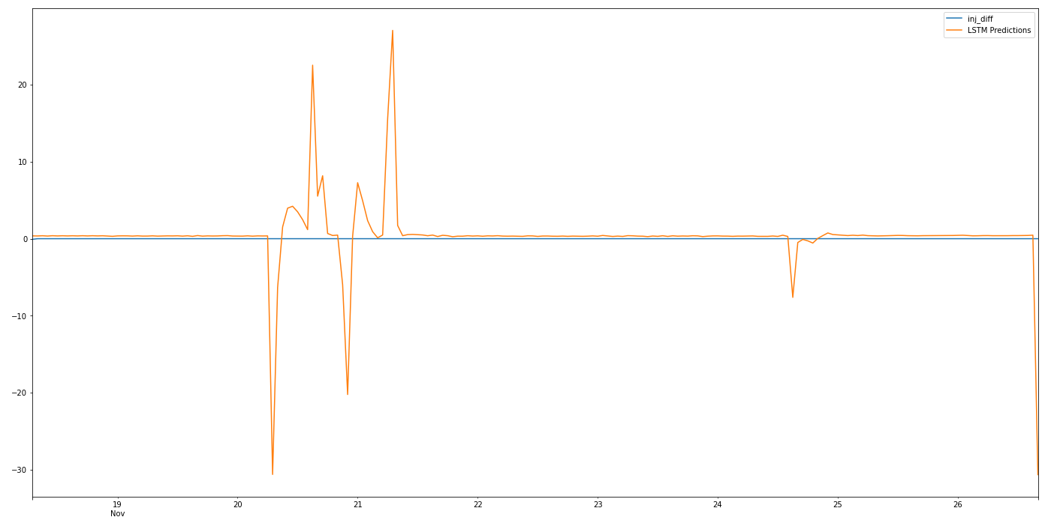
Modelling
Input – Train Data
LSTM Model
Model Evaluation/Validation
Input of blind test data, merging with existing train data and re-running model with new train data
Prediction

Slide 16
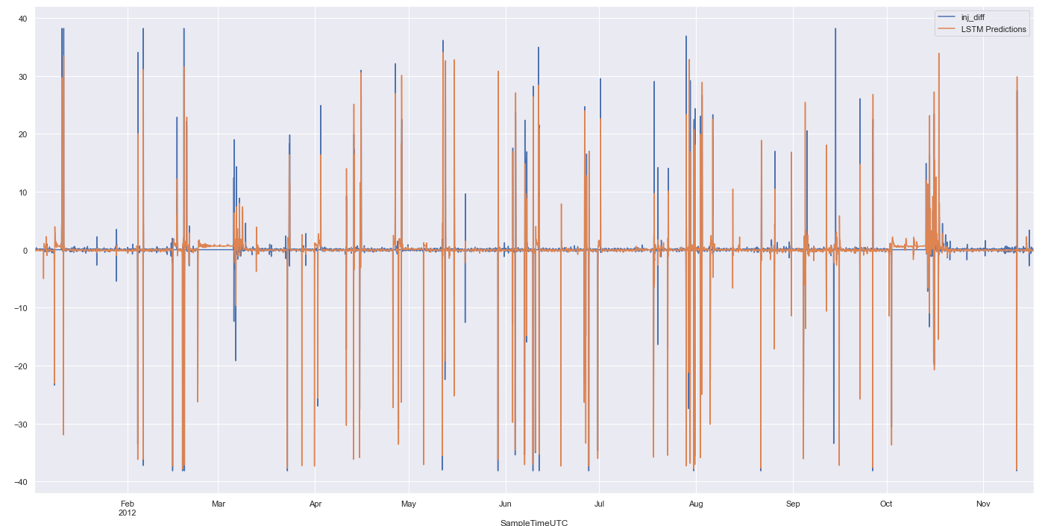
Model Validation
Able to match anomalies in injection delta
Able to mimic the small variations in the injection delta

Slide 17
Data Modelling Results
If predicted injection delta is zeros for all test timesteps, the RMSE is 5.54. This is Default.
Several sensitivities were run but only selected are displayed here
Best results (based on RMSE)
Scaling between -1 and 1
Use of DH sensor Z05 with corrected values of 0
Use of temperature and whp sensors
Z-score outlier replacement of 20, resulting inj_diff range between 30 and -30.
Vintage | Select | Default | Base (0) | 4 | 12 | 9
Scaling | Y(-1,1) | N | Y(0,1) | Y(0,1) | Y(-1,1) | Y(-1,1)
VW DH Sensor | Z05 | NA | Z09 | Z01 | Z05 | Z05
Injection WHP Sensor | Y | NA | Y | Y | Y | N
Temp Sensor | Y | NA | N | N | N | Y
Z-Score Inj_Diff | 25 | NA | 20 | 25 | 25 | 25
VW Zero Values | No | NA | Yes | No | No | No
Activation | tanh | NA | tanh | tanh | tanh | Tanh
Test RMSE | 1.31 | 5.54 | 2.65 | 1.82 | 1.98 | 1.50
Val RMSE | 1.73 | NA | 1.75 | 2.20 | 1.90 | 2.01
Val R2 | 0.77 | NA | 0.73 | 0.63 | 0.72 | 0.69
Sensitivities such as activation function, neurons, lookback, etc that are related to the model were previously optimized while selection of model with k-fold

Slide 18
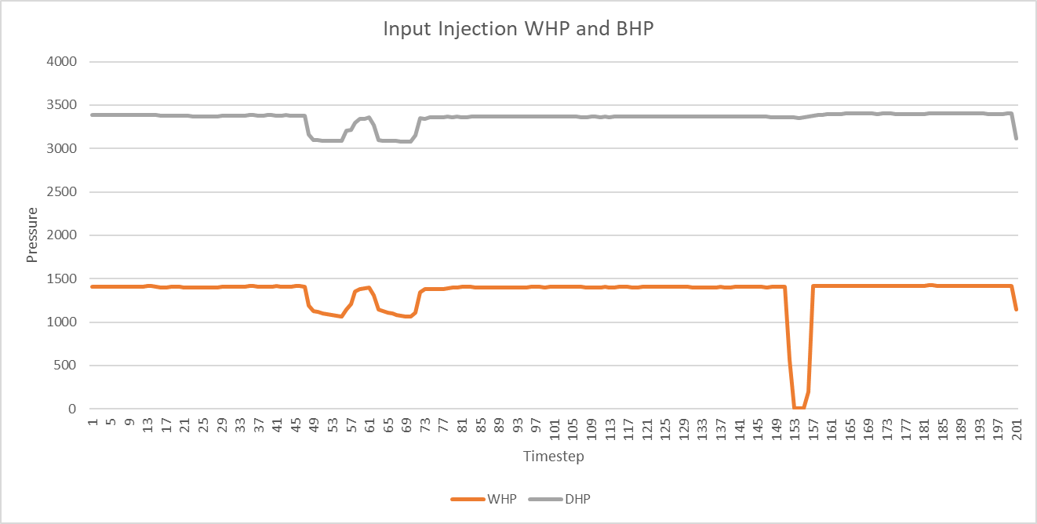
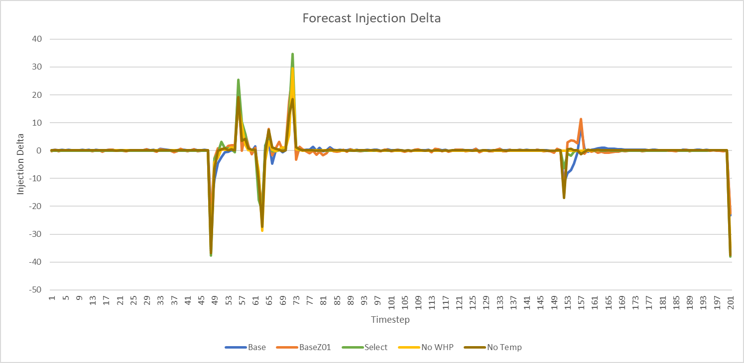
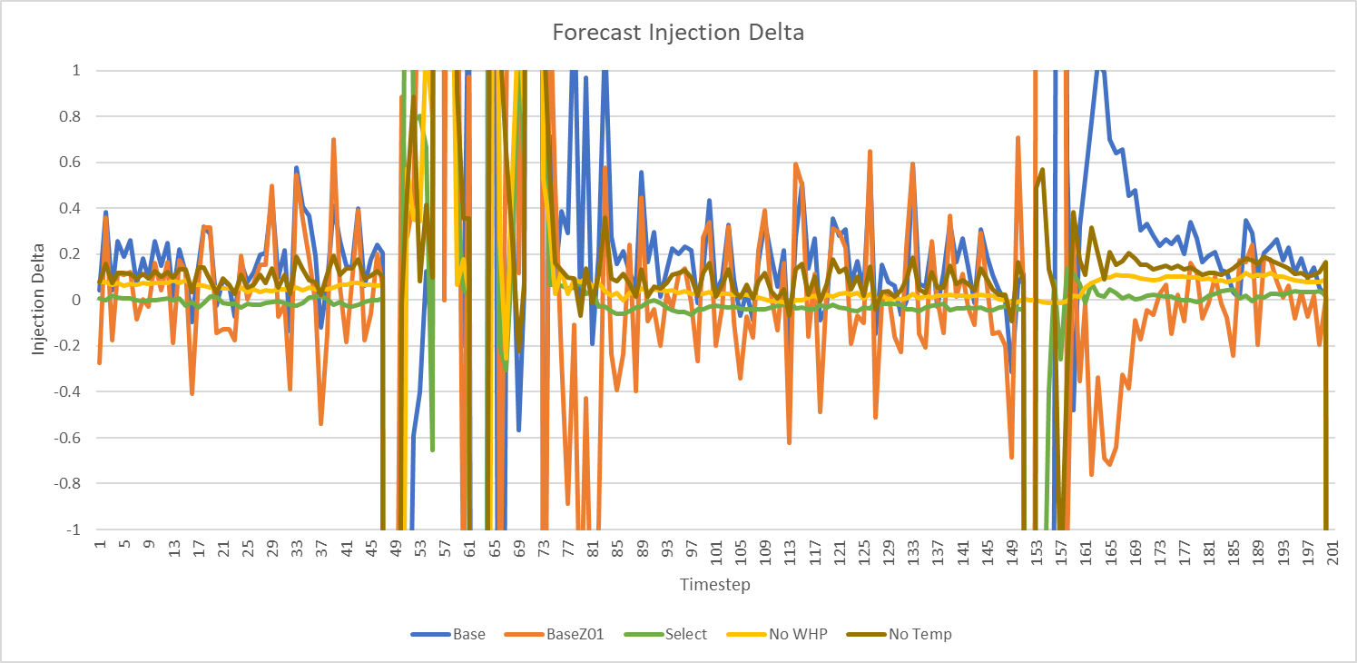
Predicted Injection Difference
Predicted models does well based on good RMSE and R2 scores on test and train data
Able to pick out large anomalies thus meeting the objective of the challenge
Also able to predict small variation in rate due – thus proving to be robust

Slide 19
Model Optimization
Explore alternative models
Improved outlier removal / nan/zero replacements
Additional Data

Slide 20
Insights
What does the data tell us?
Insights from Data Analysis

Slide 21
Insights
Injected carbon is well contained, and no leakages based on data and model
Forecasted anomalies are due to planned activities such as well shut-ins.
Most of the parameters recorded by the sensors are highly correlatable/dependent on each other – working like a system.

Slide 22
~1000 tonnes/day
995, 215
34
CO2 injection for three year in one well
Total tonnes of CO2 injected into one well
Observation sensors on two wells

Slide 23
Thank you all!
Happy to share more about our algo and journey, feel free to reach out to us
Please keep this slide for attribution

